Slide 1

Fun with Foods
Project 2: Visualize Me, Captain!
Data Boot Camp, Lesson 18.1
May 8, 2021
A Brand Name Food Analysis of Nutritional Content Using USDA Data
Meghan Conway, Ly Li, Katie Quinn, Regine Strey, Letha Varughese
Notes:
Katie
To do:
Javascript, leaflet or plotly

Slide 2
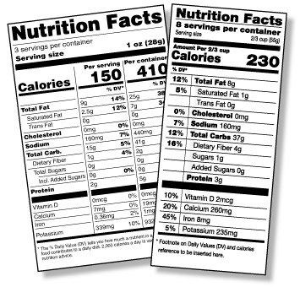
Project Rationale
Studies show that American consumers are becoming increasingly interested in farming methods and the nutritional quality of food. And, the NLEA Labeling on products is known to cause consumer confusion. To fill this gap, our project serves as a tool to search & visualize the nutrients and vitamins in all of your favorite brand-name foods.
And… if you decide that your favorite supermarket isn’t making the cut for healthy food options, head to the nearest healthy farmers market with our interactive Leaflet map.
Notes:
Katie
Our original plan: Looking at the relationship between USDA geographic soil data and farmer’s market to see if there was a connection between higher nutrient values in soils and farming; see what kind of soils your food is coming from; data didn’t cooperate so we PIVOTED TO:
Map outfitted with information on the WIC Nutrition Program for Women, Infants, and Children as well as healthy food options such as organic, vegetables, fruits, meat and grains

Slide 3

Data Sources
USDA Food Data Central (API)
“The FoodData Central API provides REST access to Food Data Central. It is intended primarily to assist application developers wishing to incorporate nutrient data into their applications or websites.”
USDA National Farmers Market Directory (.csv)
“The Farmers Market Directory lists markets that feature two or more farm vendors selling agricultural products directly to customers at a common, recurrent physical location…”
USDA Food Availability Per Capita Data System
“The food-availability-per-capita-data-system estimates the amounts and rates of retail food loss by type.”
Notes:
Katie

Slide 4
USDA Food Data Central (FDC) API Visualization
Notes:
Regine

Slide 5




Configuration
Notes:
Regine

Slide 6
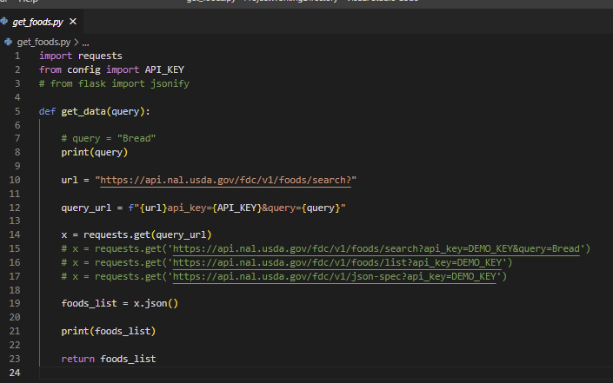
Approach
API call to USDA foods database to retrieve:
Brand
Ingredients
Nutrient information
Notes:
Regine

Slide 7
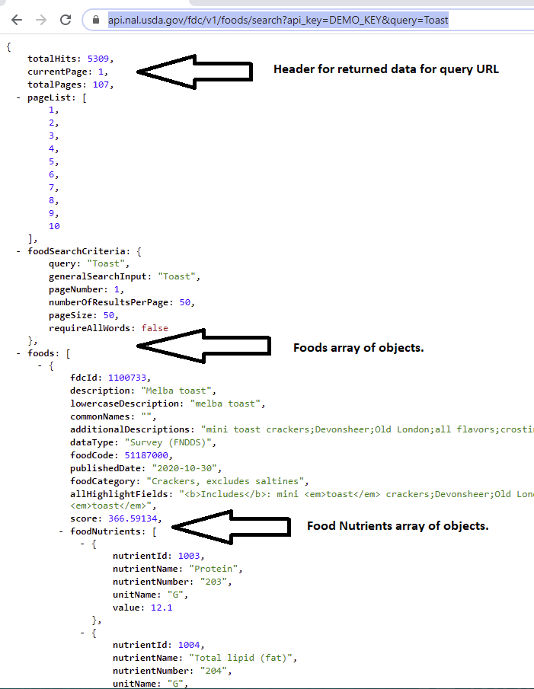
Data object returned from API call for query = “Toast”
Is converted into JSON for storage into and later retrieval from MongoDB.
Notes:
Regine

Slide 8
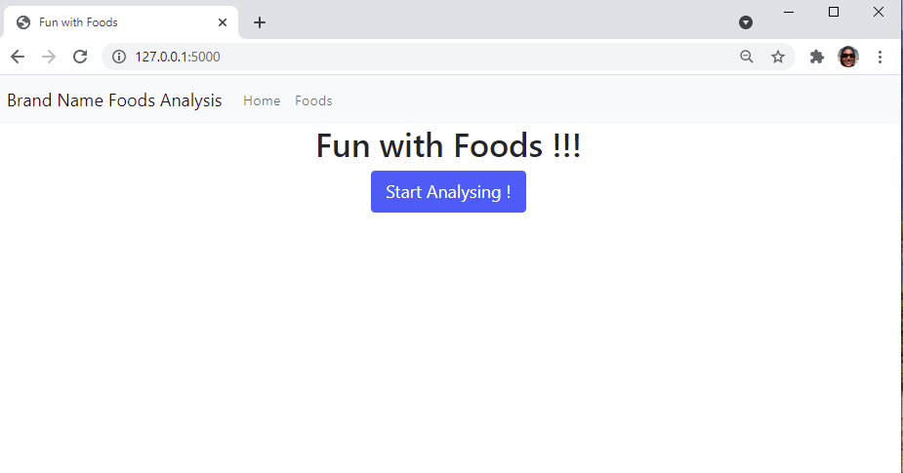
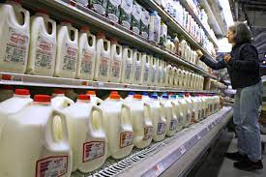

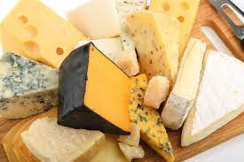
Notes:
Regine

Slide 9
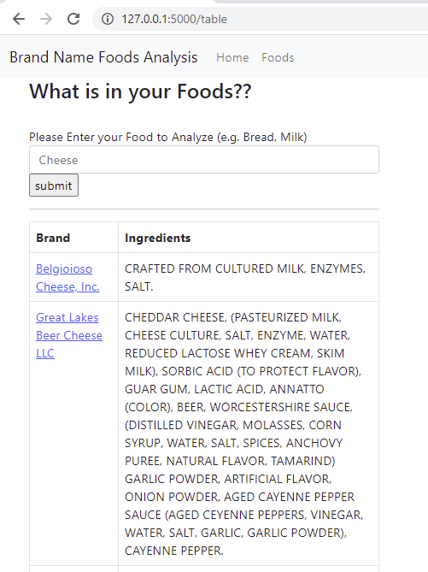
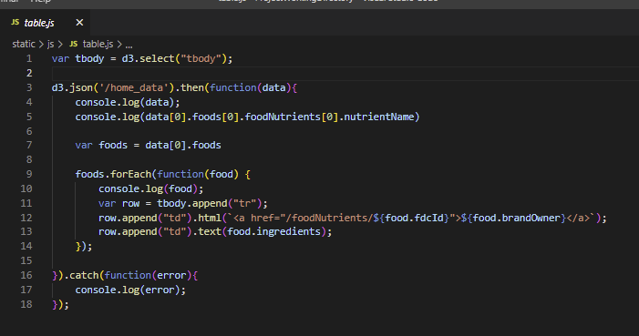
Initial table filled with MongoDB Query,
made available to table.js via D3.
“Submit” search term initiates a new API call, table refreshes.
Notes:
Regine

Slide 10
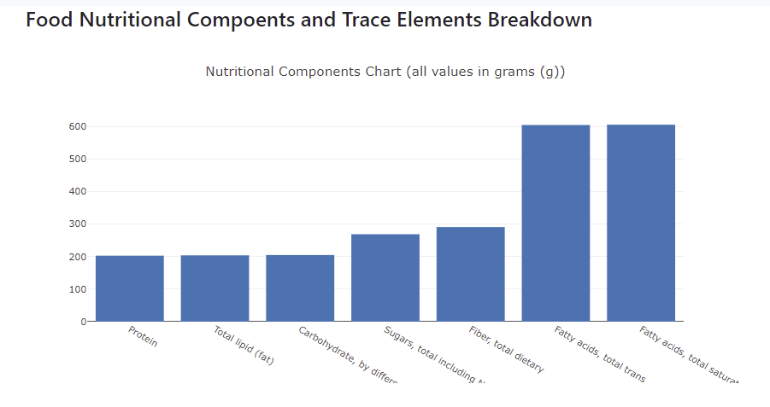
Nutritional Analysis (Visualization 1)
*This bar chart utilizes the USDA FDC API to visualize different types of nutrients in grams. A new bar chart is generated for each food that is selected on our tool.
Notes:
Regine

Slide 11
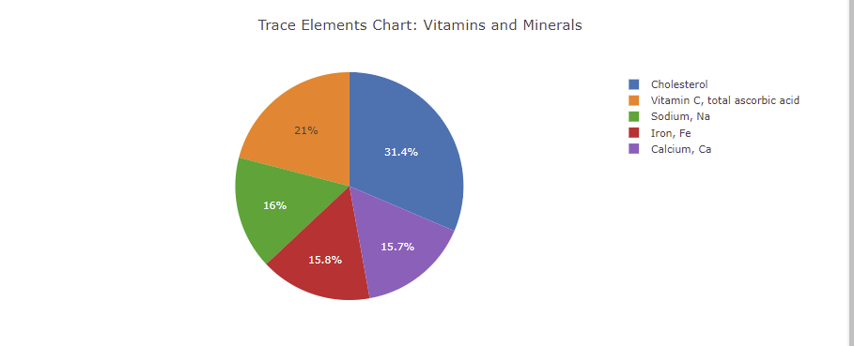
Nutritional Analysis (Visualization 2)
*This visualization creates a pie chart of 8 vitamins (cholesterol, niacin, riboflavin, thiamin, sodium, potassium, iron, and calcium) that are present in the chosen food.
Notes:
Regine

Slide 12
USDA Food Availability Per Capita Data System
Web Scraping
Notes:
ERS, a division of USDA is a national leader in measuring the people and places facing barriers to accessing healthy and affordable food and conducts research examining the consequences of food access limitations on food spending, diet, and health

Slide 13
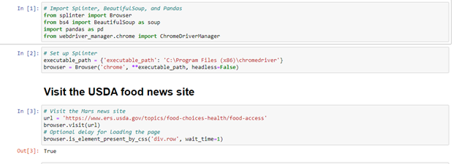
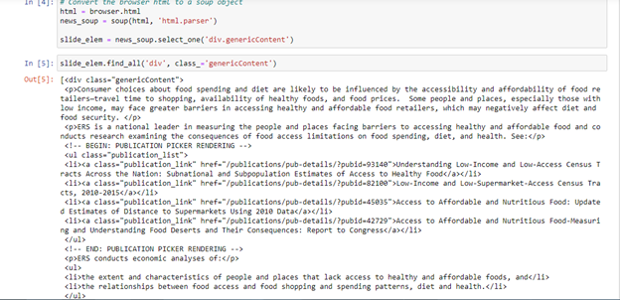
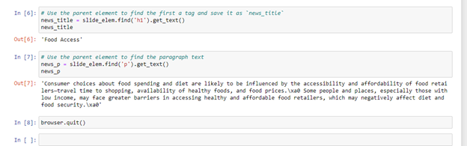
Food Access
Consumer choices about food spending and diet are likely to be influenced by the accessibility and affordability of food retailers—travel time to shopping, availability of healthy foods, and food prices.\xa0 Some people and places, especially those with low income, may face greater barriers in accessing healthy and affordable food retailers, which may negatively affect diet and food security

Slide 14
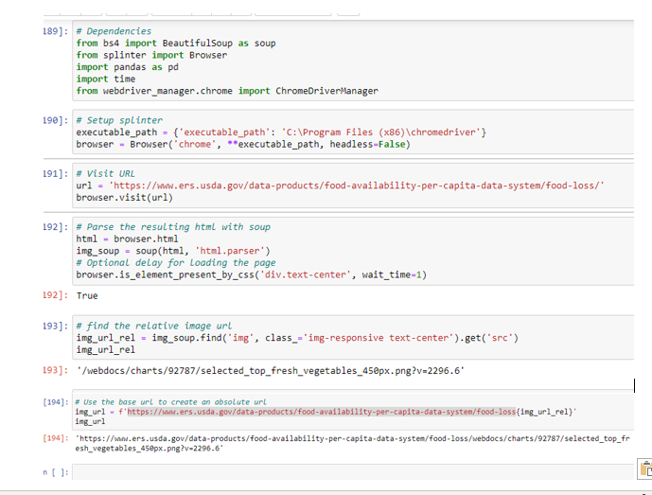
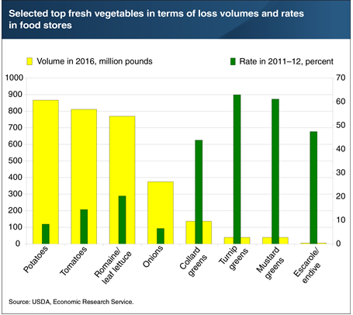
Food Loss in Food Stores- Fresh Vegetables(Visualization-3)
Notes:
While the loss rates for potatoes, tomatoes, and romaine and leaf lettuce are lower than turnip and mustard greens, their sales volumes are higher, accounting for 35 percent of food store fresh vegetable sales

Slide 15
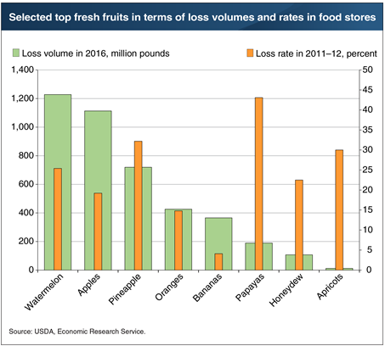
Food Loss in Food Stores- Fruits (Visualization -4)
Retail-level food loss occurs when grocery retailers
remove dented cans, misshapen produce items,
overstocked holiday foods, and spoiled foods from
their shelves.
Notes:
Loss volumes were highest for fresh watermelon and apples, reflecting the large quantities available for sale by retailers

Slide 16
USDA National Farmers Market Directory

Slide 17
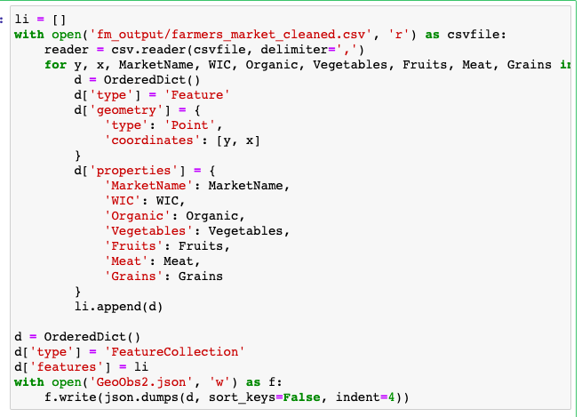
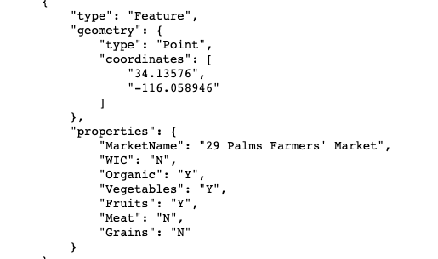
Approach
Download csv from USDA website
Clean data with Pandas
Removing lines with empty data
Choosing important fields
Generate geojson ---->
Use Leaflet to create interactive map of farmers market locations and associated properties
Notes:
Meghan
We chose to utilize the USDA National Farmer’s Market Directory in tandem with the Foods API because : 1. Same entity created both databases, adds consistency and cohesiveness to the project and 2. Hones in on the importance of health and small businesses when choosing your foods. At first, we were planning on using an API to pull the Farmer’s market information, but ended up using a CSV because it was easier to pull into GEOJSON format. GEOJSON is a very helpful and popular format among many GIS technologies because it it is simple, lightweight, and straightforward. Leaflet is very good at handling it, so I sourced some code that was able to directly translate the CSV to geojson for mapping purposes. The geojson consisted of: the geometry (latitude, longitude), marketname, WIC (women, infants, children federal funding), organic, vegetables, fruits, meats, and grains. Now Ly’s going to talk about how we turned that geojson into the simple map that you’ll see on the next slide.
Chosen properties: WIC, Organic, Vegetables, Fruits, Meat, Grains

Slide 18
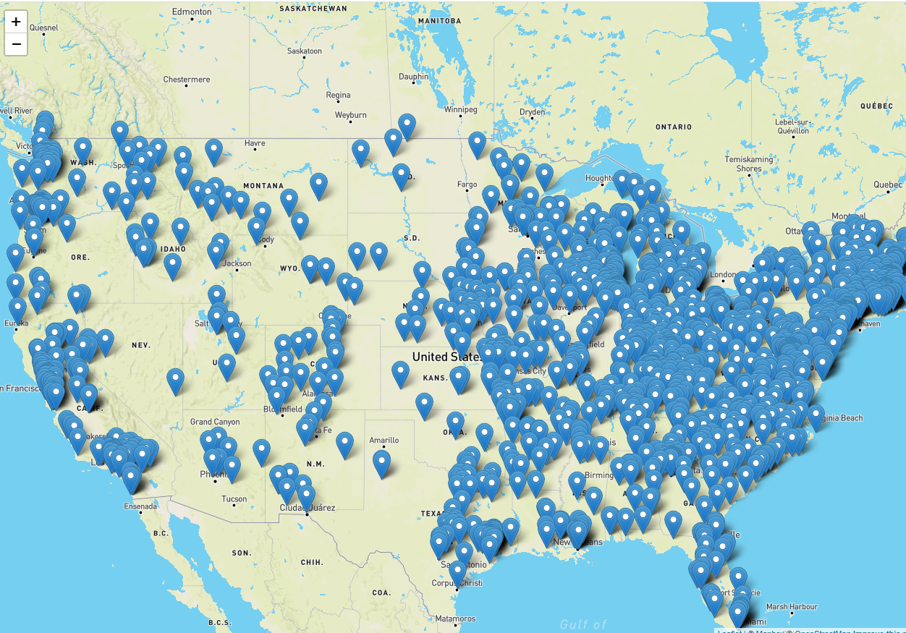
Farmers’ Markets, Continental USA-clustered in the East
Notes:
More farmers markets on the East Coast

Slide 19
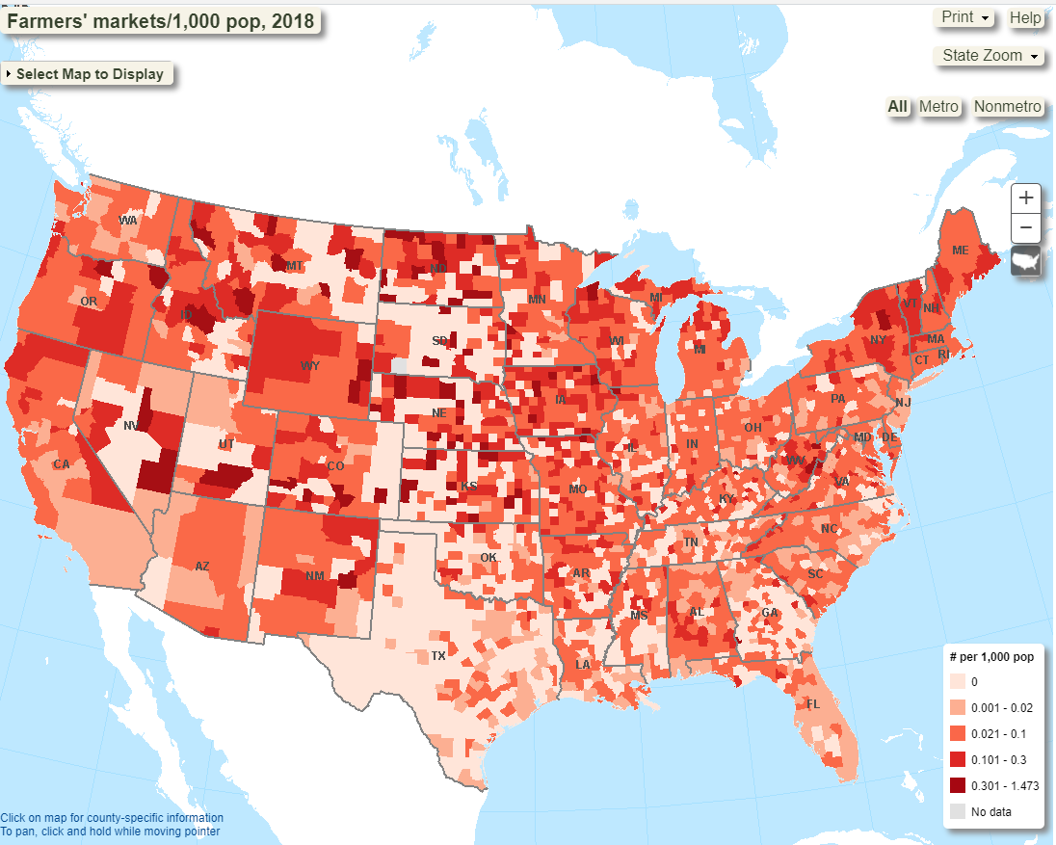
However, when we adjust for population size the trend reverses! Per capita, there are more farmers’ markets in the West! Farmers’ markets are more popular in the North than in the South.

Slide 20
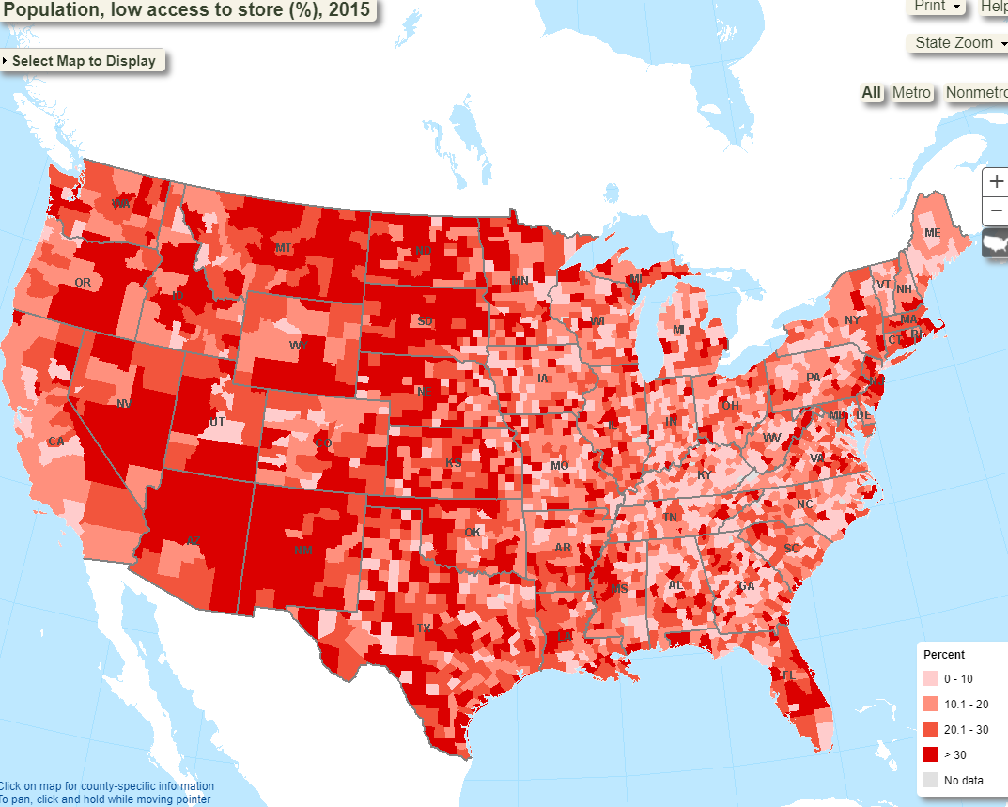
Food deserts exist in the West, farmers’ markets fill a need for people who do not have access to a grocery store

Slide 21
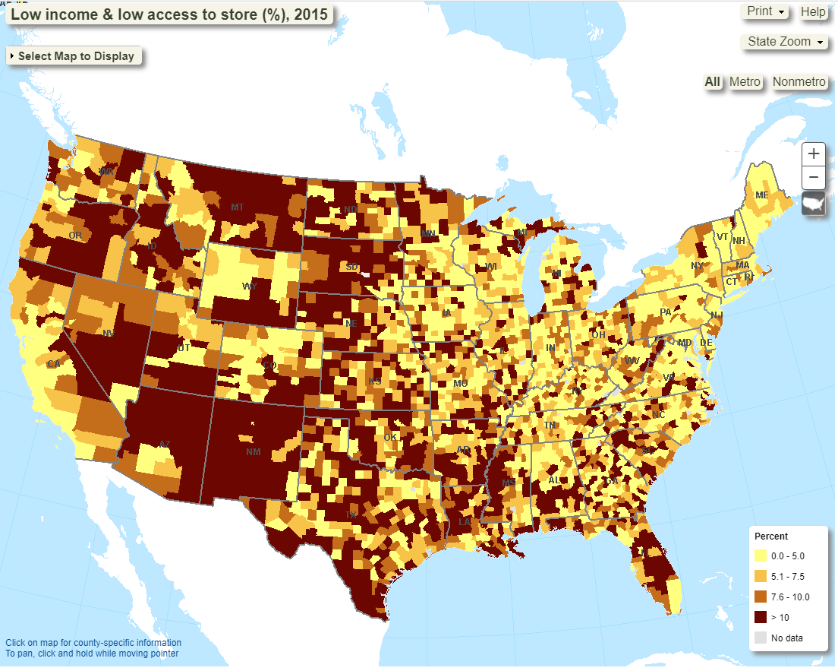
Farmers’ markets help provide grocery access to underserved communities in food deserts where people do not have access to a grocery store

Slide 22
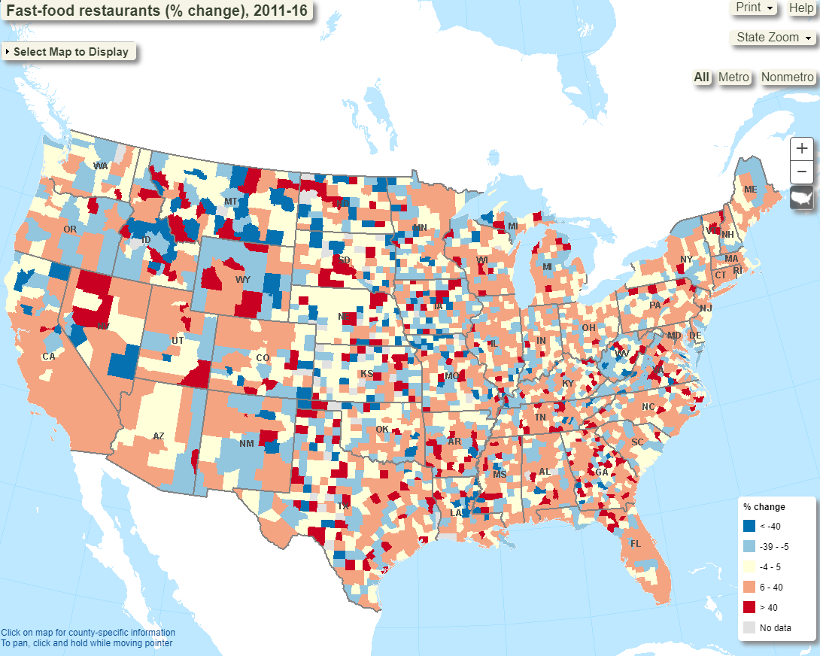
In the absence of farmers’ markets, underserved communities turn to fast food

Slide 23
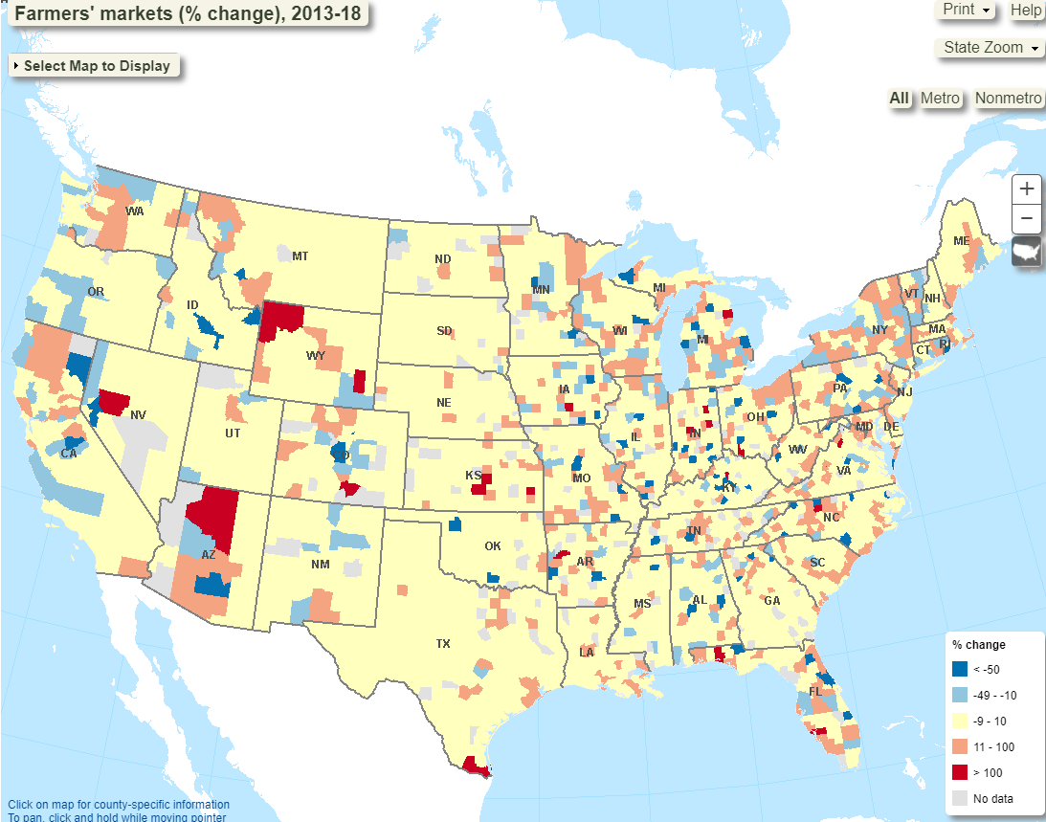
Farmers’ markets are appearing more rapidly in the West but trends are locally driven, vary by county not state

Slide 24
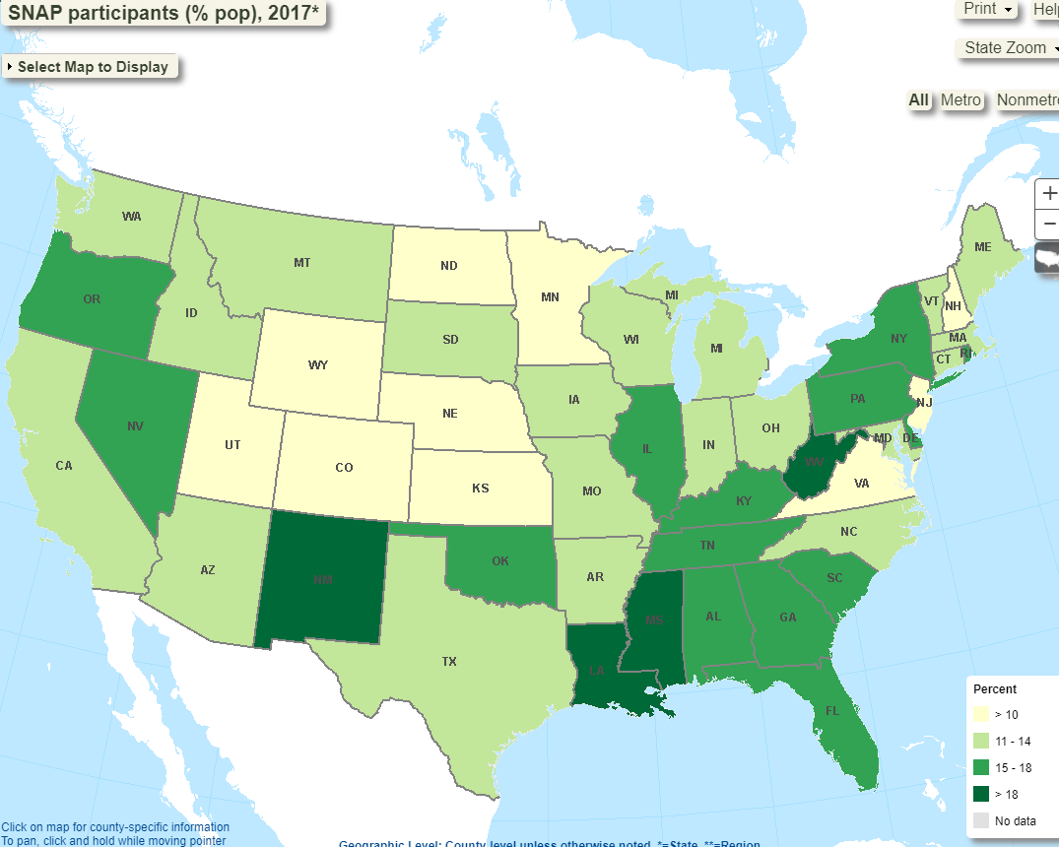
Supplemental Nutrition Assistance Program is a measure of food insecurity; NV, NM, WV, MS, LA are at highest risk. Problem worse in the South.

Slide 25
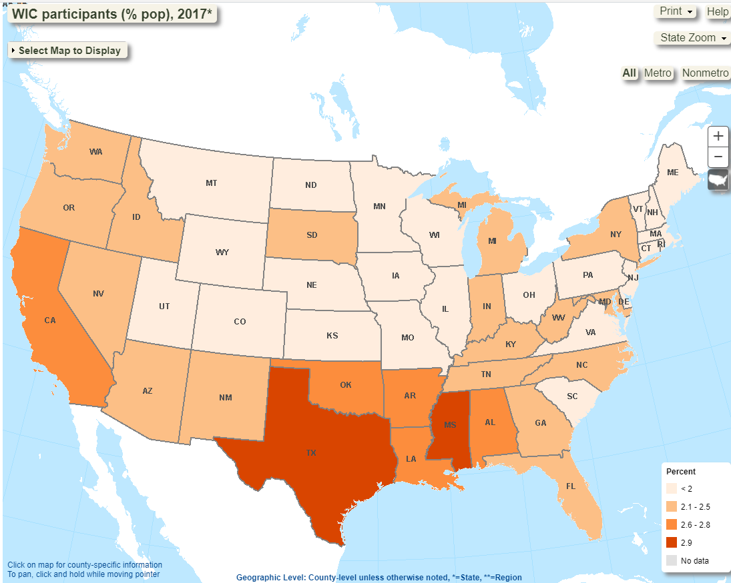
Women, Infants & Children is assistance program to combat child hunger: worse in the South

Slide 26
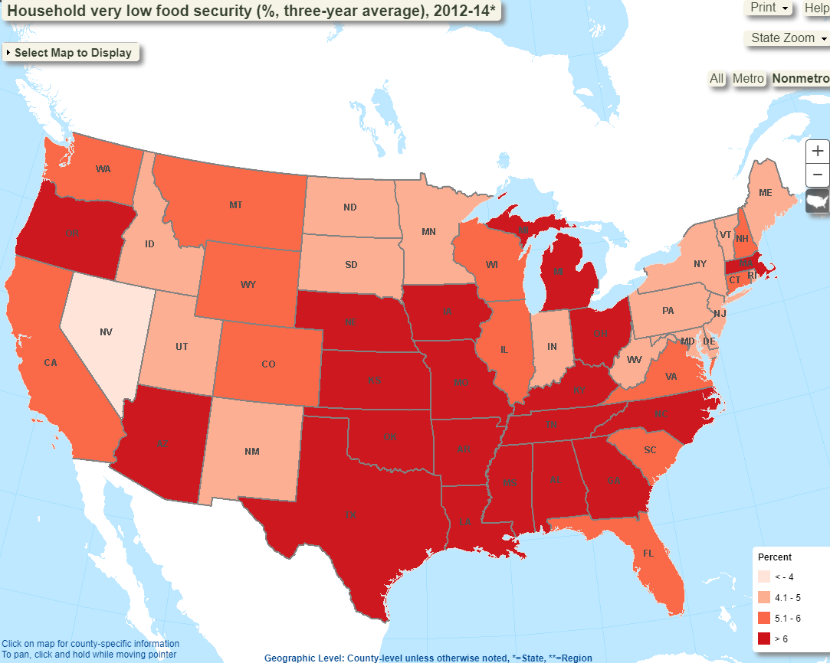
Food insecurity is consistently concentrated in the South Central states-farmers’ markets & invigorating local food economies may be part of the solution for better food access outcomes

Slide 27
If we had more time...
Integrate Leaflet map with flask app to create a cohesive website
More styling with CSS
Additional information on what each vitamin means for your health, how much you should get a day
A way to track vitamins and reach toward a daily goal
Could be helpful for those with iron deficiency (or other vitamin deficiencies) if developed into a mobile app
Possibly focus on supermarkets instead of farmers markets
Provide maps to places that have the brand of food that most fits your vitamin needs
Notes:
Meghan
These are some future recommendations if we had some more time to work on this project. The first is to integrate the Leaflet map with the Flask app to create a cohesive website. The map ended up getting done a little later than we expected, so we did not integrate it in fear of accidentally tampering with what was already working. Additionally, we would have added more styling with CSS (especially font) and making the website more visually appealing by adding user-friendly features like a drop-down menu with food categories or suggestions for related foods. The latter probably would have been much more involved. Other features might include a way to track vitamins and reach toward a daily goal, which could be helpful for those with an iron deficiency (or other vitamin deficiencies) if developed into a mobile app. Because the data is so pivotable, there are endless applications for this idea as we move forward in promoting healthy eating. Thank you!

Slide 28
Questions?

